Slide 1
Module 2, Section 5: AWS Core Services – Elastic Load Balancing Amazon CloudWatch Auto Scaling
© 2018, Amazon Web Services, Inc. or its Affiliates. All rights reserved.
Notes:
Welcome to Module 2, Section 5 - AWS Core Services; including Elastic Load Balancing, Amazon CloudWatch, and Auto Scaling. In this module, we will learn how each of these services work both independently and together to help you deploy highly available and optimized workloads on AWS.

Slide 2
What’s In This Module
Part 1: Elastic Load Balancing (ELB)
Part 2: Amazon CloudWatch
Part 3: Auto Scaling
Notes:
In this module we will review Elastic Load Balancing (ELB), Amazon CloudWatch and Auto Scaling, to build robust and highly available architectures.

Slide 3
Module Objectives
Discuss key concepts related to the Elastic Load Balancing (ELB), Amazon CloudWatch, and Auto Scaling to understand:
How to distribute traffic across Amazon Elastic Compute Cloud (EC2) instances using Elastic Load Balancing (ELB).
The ability of Auto Scaling to launch and release servers in response to workload changes.
How CloudWatch enables you to monitor AWS resources and applications in real time.
Notes:
Upon completing this module, you’ll understand key concepts related to Elastic Load Balancing (or ELB), Amazon CloudWatch, and Auto Scaling.
The goal of this module is to:
Learn how to distribute traffic across Amazon Elastic Compute Cloud instances using Elastic Load Balancing (ELB)
Discover the ability of Auto Scaling to launch and release servers in response to workload changes.
Realize how CloudWatch enables you to monitor AWS resources and applications in real time.

Slide 4
Part 1: Elastic Load Balancing (ELB)
Notes:
Introducing Part 1: Elastic Load Balancing (ELB). ELB automatically distributes incoming application traffic across multiple targets, such as Amazon EC2 instances, containers, and IP addresses.

Slide 5
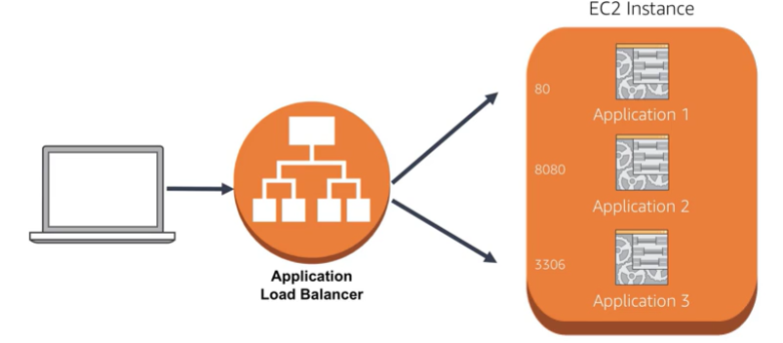

What is a Load Balancer?
Load Balancer acts as the “traffic cop”.
Automatically distributes incoming application traffic across multiple targets, such as Amazon Elastic Compute Cloud (EC2)instances, containers, and Internet Protocol (IP) addresses.
Notes:
Modern high-traffic websites must serve hundreds of thousands, if not millions, of concurrent requests from users or clients and return the correct text, images, video, or application data, all in a fast and reliable manner. To cost-effectively scale to meet these high volumes, modern computing best practice generally requires adding more servers.
A load balancer acts as the “traffic cop” sitting in front of your servers and routing client requests across all servers capable of fulfilling those requests in a manner that maximizes speed and capacity utilization and ensures that no one server is overworked, which could degrade performance. If a single server goes down, the load balancer redirects traffic to the remaining online servers (such as Amazon Elastic Compute Cloud instances, containers, and IP addresses). When a new server is added to the server group, the load balancer automatically starts to send requests to it.
Let’s start by looking at ELB and the three types of load balancers that all feature the high availability, automatic scaling, and robust security necessary to make your applications fault tolerant.

Slide 6
Types of Elastic Load Balancers
Application Load Balancer (ALB) | Network Load Balancer (NLB) | Classic Load Balancer (CLB)
 |  | PREVIOUS GENERATION for HTTP, HTTPS, and TCP
Flexible application management Advanced load balancing of HTTP and HTTPS traffic Operates at the request level (Layer 7) | Extreme performance and static IP for your application Load balancing of TCP traffic Operates at the connection level (Layer 4) | Existing application that was built within the Amazon EC2-Classic network Operates at both the request level and connection level
HTTP HTTPS
TCPT
Transmission Control Protocol (TCP)
Notes:
ELB offers three types of load balancers: Application Load Balancer, Network Load Balancer, and Classic Load Balancer.
First, we have an Application Load Balancer (ALB) that functions at the application level. It supports content-basing routing and applications that run in containers. It supports a pair of industry-standard protocols (websocket and http/2) and can provide additional visibility into the health of target instances and containers.
Next, we have Network Load Balancers (NLB) which are designed to handle tens of millions of requests per second while maintaining high throughput at ultra low latency. NLB is ideal for load balancing Transmission Control Protocol (TCP) traffic and is capable of handling millions of requests per second while maintaining ultra-low latencies.
Finally, the Classic Load Balancer (CLB) provides the basic load balancing across multiple Amazon EC2 instances and operates at both request and connection level. This ideal for applications that were built within the Amazon EC2-Classic network.
To learn more, select the link.
https://aws.amazon.com/elasticloadbalancing/details/#compare.

Slide 7

ELB Use Cases
Access Through a Single Point
Decouple Application Environment
Provide High Availability and Fault Tolerance
Increase Elasticity and Scalability
Notes:
There are many reasons to use a load balancer:
To secure access to your web servers through a single exposed point of access.
To decouple your environment to using both public facing and internal load balancers.
To provide high availability and fault tolerance with the ability to distribute traffic across multiple Availability Zones.
To increase elasticity and scalability with minimal overhead.

Slide 8
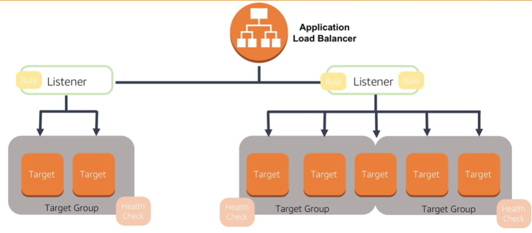
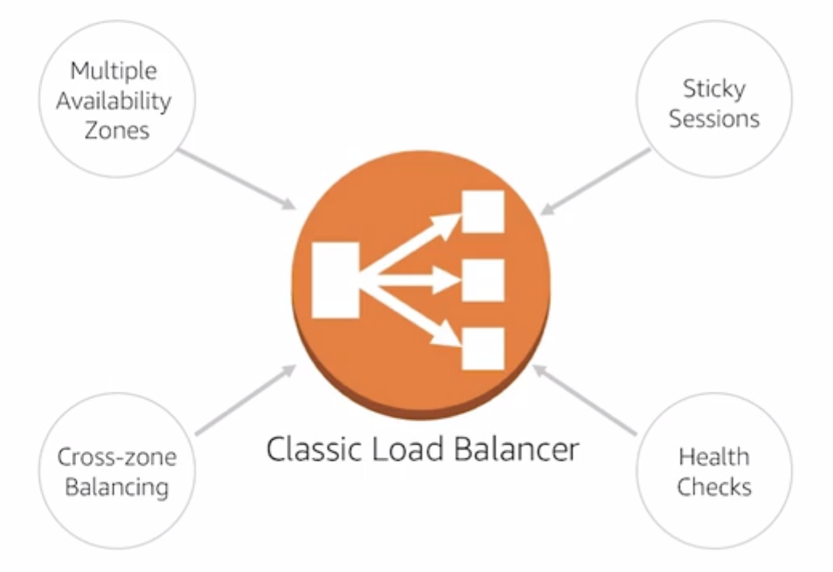
Classic Load Balancer Use Cases
Access servers through single point
Decouple the application environment
Provide high availability and fault tolerance
Increase elasticity and scalability
Notes:
The Classic Load Balancer is a distributed software load balancing service that enables the use of many helpful features packaged into a managed solution.
Some of the use cases for the Classic Load Balancer are securing access to your web servers through a single exposed point of access, decoupling your application environment, using both internet and internal load balancers, providing high availability and fault tolerance with the ability to distribute traffic across multiple Availability Zones, and increase elasticity and scalability with minimal overhead.

Slide 9
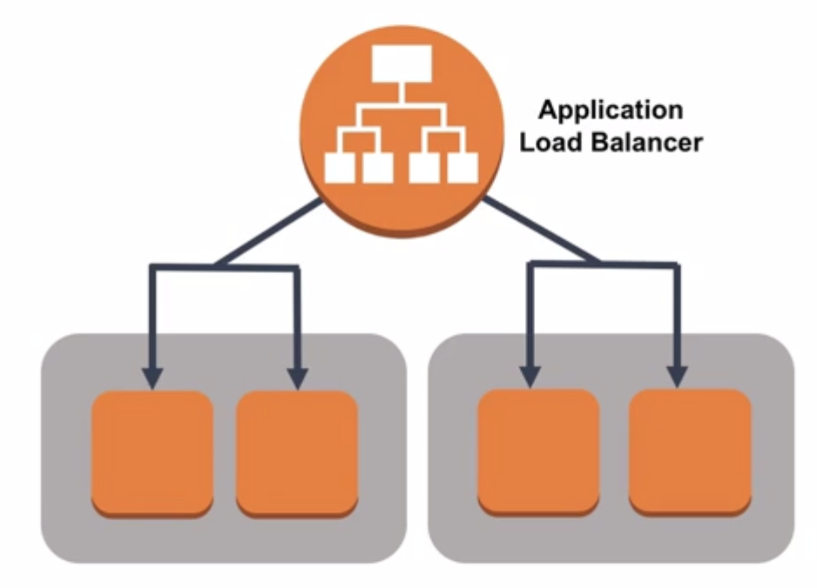
Application Load Balancer Features
Path- and host-based routing
Native IPv6 Support
Dynamic ports
Additional supported request protocols
Deletion protection and request tracking
Enhanced metrics and and access logs
Targeted health checks
Notes:
The Application Load Balancer offers most of the features offered by the Classic Load Balancer; however, it adds some important features and enhancements that make it applicable for unique use cases.
These features include path- and host-based routing, native IPv6 support, dynamic ports, additional supported request protocols, deletion protection and request tracking, enhanced metrics and access logs, and targeted health checks.

Slide 10
Application Load Balancer Use Cases
Notes:
There are a number of scenarios in which you would use the Application Load Balancer. One is the ability to use containers to host your micro services and route to those applications from a single load balancer.
The Application Load Balancer allows you to route different requests to the same instance, but differ the path based on the port. If you have different containers listening on various ports, you can set up routing rules to distribute traffic to only the desired backend application.

Slide 11
Application Load Balancer Use Cases
Notes:
In the use case displayed, we can see how the Application Load Balancer routes and organizes backend targets. When configuring the listeners for the load balancer, you create rules in order to direct how the requests received by the load balancer will be routed to the backend targets.
To register those targets to the load balancer and configure the health check the load balancer will use for the targets, you create target groups. As we see here, targets can also be members of multiple target groups.

Slide 12

Network Load Balancer Use Cases
Sudden and volatile traffic patterns
Single static IP address per Availability Zone
Ideal for applications that require extreme performance
Notes:
Network Load Balancers are optimized to handle sudden and volatile traffic patterns while using a single static IP address per Availability Zone.
Since it handles millions of requests per second while maintaining ultra-low latencies, it is ideal for the applications that require extreme performance.

Slide 13

Load Balancer Monitoring
View Hypertext Transfer Protocol (HTTP) responses
See number of healthy and unhealthy hosts
Filter metrics based on Availability Zones or load balancer
Notes:
ELB provides many metrics by default. These metrics allow you to see Hypertext Transfer Protocol (HTTP) responses, the number of healthy and unhealthy hosts behind the load balancer, and you can filter these metrics based on the Availability Zone of the backend instances or based on the load balancer that you are using.
For health checks, the load balancer allows you to see the number of healthy and unhealthy Amazon EC2 hosts behind the load balancer. This is accomplished with a simple attempted connection request to the Amazon EC2 instance. To discover the availability of your Amazon EC2 instances, a load balancer periodically sends pings, attempts connections, or sends requests to test the Amazon EC2 instances. These tests are called health checks.

Slide 14
In Review
Load balancers automatically distribute incoming traffic load
ELB offers three types of load balancers:
Application Load Balancer
Network Load Balancer
Classic Load Balancer
ELB offers several monitoring tools.
Notes:
In summary, load balancers are used to distribute traffic load. Load balancers are used to increase capacity (concurrent users) and reliability of applications.
There are three Elastic Load Balancing products including: Application Load Balancer, Network Load Balancer, and Classic Load Balancer.
Application Load Balancer is best suited for load balancing of HTTP and HTTPS traffic and provides advanced request routing targeted at the delivery of modern application architectures, including micro services and containers.
Network Load Balancer is best suited for load balancing of TCP traffic where extreme performance is required.
Classic Load Balancer provides basic load balancing across multiple Amazon EC2 instances and operates at both the request level and connection level.
You can use the monitoring tools offered by ELB to evaluate the health of your implementation.
To learn more about ELB select the link. https://aws.amazon.com/elasticloadbalancing/.

Slide 15
Part 2: Amazon CloudWatch
Notes:
Introducing Part 2: Amazon CloudWatch.
Before we get into the details of scaling, let’s review a tool that helps you leverage resources efficiently by providing insight into your resources.

Slide 16
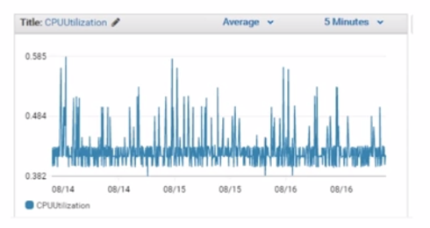

Leveraging Information to Optimize
To leverage AWS in an efficient way, you need insight into your AWS resources:
How do I know when I should launch more Amazon EC2 instances?
Is my application's performance or availability being affected by a lack of sufficient capacity?
How much of my infrastructure is actually being used?
Notes:
How do you capture this information? Without any kind of instrumentation, you really are flying blind. To leverage resources efficiently, you need insight into your resources.
You need to understand:
How do I know when I should launch more Amazon EC2 instances?
Is my application’s performance or availability being affected by a lack of sufficient capacity?
How much of my infrastructure is actually being used?

Slide 17
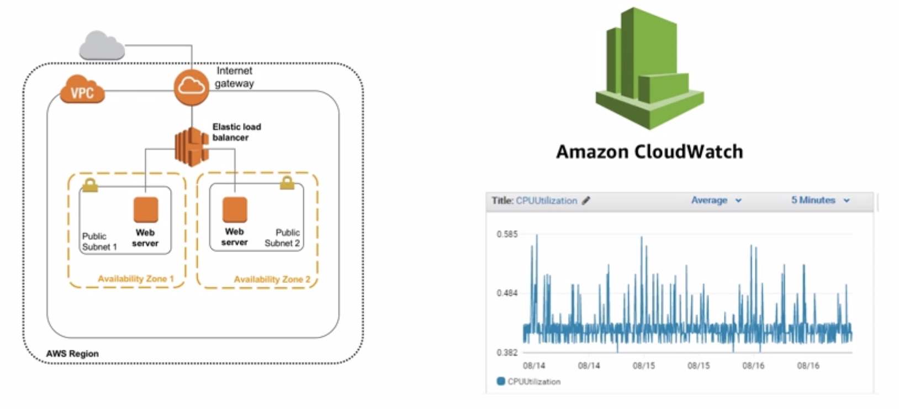
Monitoring Resource Performance
Notes:
You can capture this information with Amazon CloudWatch.
When you run your applications on Amazon EC2 instances, it is critical to monitor the performance of your workload using Amazon CloudWatch. While monitoring workload performance, you should ask yourself two critical questions:
How can I ensure that my workload has enough Amazon EC2 resources to meet fluctuating performance requirements?
How can I automate Amazon EC2 resource provisioning to occur on-demand?
CloudWatch helps with performance monitoring, but by itself will not add or remove Amazon EC2 instances. This is where Auto Scaling comes into the picture.
With Amazon EC2 Auto Scaling, you can maintain the health and availability of your fleet, also dynamically scale your Amazon EC2 instances to meet demands during spikes and lulls.

Slide 18

What is Amazon CloudWatch?
Track resource and application performance.
Collect and monitor log files.
Get notified when an alarm goes off.
Amazon
CloudWatch
Notes:
The primary function of Amazon CloudWatch is to enable you to track and monitor the performance and health of your resources and applications. You can also use CloudWatch to collect and monitor log files from Amazon EC2 instances, AWS CloudTrail, Amazon Route 53, and other sources.
Amazon CloudWatch is a distributed statistics gathering system. It collects and tracks your metrics from your applications. You also have the ability to create and use your own custom metrics and get notified when an alarm goes off.
CloudWatch has two different monitoring options:
Basic Monitoring for Amazon EC2 instances: Seven pre-selected metrics at five-minute frequency and three status check metrics at one-minute frequency, for no additional charge.
Detailed Monitoring for Amazon EC2 instances: All metrics available to Basic Monitoring at one-minute frequency, for an additional charge. Instances with Detailed Monitoring enabled allows data aggregation by Amazon EC2 AMI ID and instance type.
CloudWatch retains metrics for 15 months, free of charge. CloudWatch Metrics supports the following three retention schedules:
1 minute datapoints are available for 15 days
5 minute datapoints are available for 63 days
1 hour datapoints are available for 455 days
Learn more about CloudWatch by selecting the link.
https://aws.amazon.com/cloudwatch/.

Slide 19

Amazon CloudWatch Terms
Metric
Alarm
Events
Amazon
CloudWatch
Notes:
CloudWatch consists of three primary components: metrics, alarms, and events.
A CloudWatch metric is a specific data point from one of the resources or applications that you are monitoring. Many AWS resources submit metrics to CloudWatch automatically as part of the service. You can also capture your own metrics.
A CloudWatch alarm sends out a notification message when a tracked metric reaches a specified value for a specified period of time. The notification can be sent to an Amazon SMS topic which then push it to a mobile device or send an email or notify an auto scaling policy to take action.
A CloudWatch event can monitor AWS resources and deliver a near real-time stream of events that describe the changes in resources. That stream of resource changes can be sent to other AWS resources.

Slide 20

Amazon CloudWatch Alarm Examples
Amazon EC2
Amazon RDS
Elastic Load Balancing
If CPU utilization is > 60% for 5 minutes…
If the number of simultaneous connections is > 10 for 1 minute…
If number of healthy hosts is < 5 for 10 minutes…
Notes:
Displayed are some examples of CloudWatch alarms. Take a moment to review each one.

Slide 21
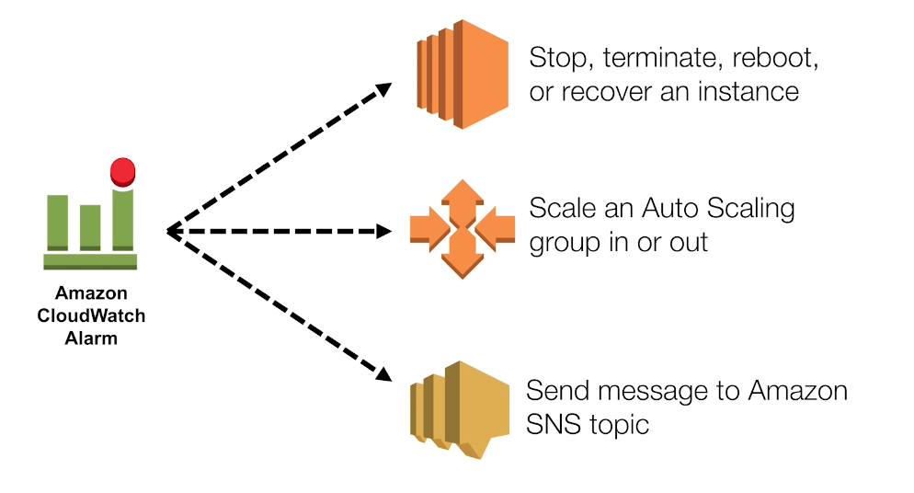
Amazon CloudWatch Actions
Notes:
There are a number of actions that you can choose to take based on the CloudWatch alarms.
One of those actions is to automatically scale. Let’s learn what automatic scaling is and how it works.

Slide 22
In Review
Amazon CloudWatch tracks and monitors the performance and health of your resources and applications.
It enables you to:
Track resource and application performance
Collect and monitor log files
Get notified when an alarm goes off
CloudWatch consists of three primary components: metrics, alarms, and events.
Amazon
CloudWatch
Notes:
In summary, Amazon CloudWatch tracks and monitors the performance and health of your resources and applications.
It enables you to:
Track resource and application performance
Collect and monitor log files
Get notified when an alarm goes off
CloudWatch consists of three primary components: metrics, alarms, and events.

Slide 23
Part 3: Scaling
Notes:
Introducing Part 3: Scaling.
So, what exactly is scaling and why is it important? Let’s find out!

Slide 24

What is Scaling?
Scaling provides a simple, powerful user interface that lets you build scaling plans for resources including:
Amazon EC2 instances and Spot Fleets
Amazon DynamoDB tables
Amazon DynamoDB tables and indexes
Amazon Aurora Replicas
Scaling
Notes:
Scaling provides a simple, powerful user interface that lets you build scaling plans for resources including:
Amazon EC2 instances and Spot Fleets
Amazon DynamoDB tables
Amazon DynamoDB tables and indexes
Amazon Aurora Replicas
Scaling can be used with a number of AWS resources. With Amazon EC2, Auto Scaling helps you to verify that you have the correct number of Amazon EC2 instances available to handle the load for your application.
Using Auto Scaling removes the guesswork of how many resources you need at a point in time to meet your workload requirements.

Slide 25

Scaling Out and Scaling In
Elastic Load Balancing
Auto Scaling group
Auto Scaling group
Auto Scaling group
Base Configuration
Scaling Out
Scaling In
Launch Instances
Terminate Instances
Notes:
So what exactly do we mean by scaling? The first thing we have to do is define the concepts of scaling out and scaling in. If scaling adds more instances, this is termed scaling out. When scaling terminates instances, this is scaling in.
Scaling can automatically adjust the number of Amazon EC2 instances running in your workload based on either conditions that you defined. For example, CPU utilization over 80%) or on a schedule. Remember, you have control as to what initiates these events.

Slide 26
Scaling
Launches or terminates instances based on specified conditions.
Automatically registers new instances with load balancers when specified.
Can launch across Availability Zones.
Notes:
Scaling launches or terminates instances based on specified conditions. This service is designed to assist you in building a flexible system that can adjust and be modified depending on changes in customer demand.
With automatic scaling, you can avoid limitations of being able to create new resources. Instead, you can create new resources on-demand or have scheduled provisioning. If you specify scaling policies, then scaling can launch or terminate instances as demand on your application increases or decreases. Scaling integrates with ELB to enable you to attach one or more load balancers to an existing Automatic Scaling group.
After you attach the load balancer, it automatically registers the instances in the group and distributes incoming traffic across the instances. When one Availability Zone becomes unhealthy or unavailable, a new instance will be launched in an unaffected Availability Zone. When the unhealthy Availability Zone returns to a healthy state, automatic scaling automatically redistributes the application instances evenly across all of the Availability Zones for your group.
Automatic scaling does this by attempting to launch new instances in the Availability Zone with the fewest instances. If the attempt fails, however, automatic scaling attempts to launch in other Availability Zones until it succeeds. This ensures that your applications and systems are always available no matter what the load is.

Slide 27
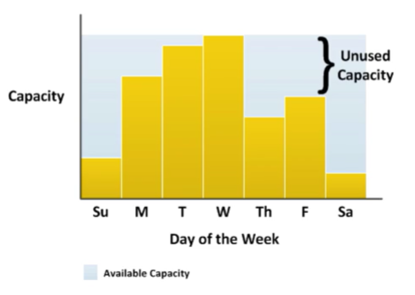
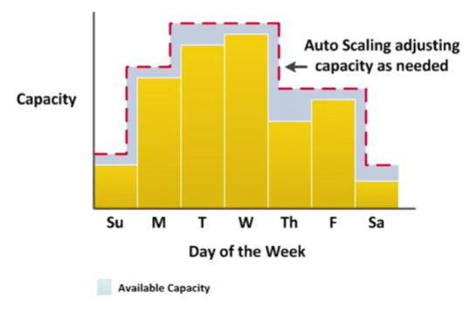
Capacity Management
Notes:
Let's look at an example workload. We will use CloudWatch to measure Amazon EC2 resource requirements over a standard week. Note that the resource requirements vary with Wednesday requiring the most capacity, and Saturday the least. We could go the route of allocating more than enough Amazon EC2 capacity to always be able to meet our highest demand time, in this case Wednesday. However, this means that we are running resources that will be underutilized most days of the week. This is an option, but our costs are not optimized.
On the other end of the scale, we could allocate fewer Amazon EC2 instances, thus reducing costs. This means that we are under-capacity on certain days. If we don't solve our capacity problem, our application could underperform or potentially even time out for the user. Obviously, this is not a good thing.
Automatic scaling allows you to add or remove Amazon EC2 instances based on conditions that you specify. Automatic scaling is especially powerful in environments with fluctuating performance requirements. This allows you to maintain performance and minimize costs.

Slide 28

Typical Weekly Traffic at Amazon.com
Provisioned Capacity
Sunday
Monday
Tuesday
Wednesday
Thursday
Friday
Saturday
Notes:
Let’s look at another example.
Needless to say, the retail company Amazon.com is one of the largest AWS customers. Typically, the incoming traffic is very predictable. Before Amazon.com moved their infrastructure onto AWS, they had a traditional data center like many other companies. In order to support the peak load, your data center must provide enough hardware and software to support the capacity.

Slide 29


November Traffic to Amazon.com
76%
Provisioned capacity
The challenge is to efficiently guess the unknown quantity of how much compute capacity you need.
24%
November
Notes:
Amazon.com experiences a seasonal peak in November (Black Friday). Because of this peak in late November, they had to invest in enough resources to support this seasonal peak, knowing that this only occurs a certain time of the year. As the business grew, Amazon.com had to keep investing in additional hardware and software.
At some point, they ran out of space so they had to add a new data center. The problem is that about 76% of the resources are idle for most of the year. But if you don’t have enough compute capability to support the seasonal peak, the server can crash and your business can lose customer confidence.

Slide 30
Automatic Scaling Components
Launch Configuration
Auto Scaling Policy
Auto Scaling Group
WHAT?
AMI
Instance type
Security groups
Roles
WHERE?
VPC and subnet(s)
Load balancer
Minimum instances
Maximum instances
Desired capacity
WHEN?
Scheduled
On-demand
Scale-out policy
Scale-in policy
Notes:
So how do you automatically scale? Three components are required for automatic scaling:
First, create a launch configuration.
Next, create an automatic scaling group.
Then define at least one automatic scaling policy.
What is a launch configuration?
This is about defining what will be launched by automatic scaling. Think of all the things that you would specify when you launch an Amazon EC2 instance from the console, such as which Amazon Machine Image (AMI) to use, what instance type, security groups, or roles to apply to the instance.
What is an automatic scaling group?
This is about defining where the deployment takes place and some boundaries for the deployment. This is where you define which VPC to deploy instances, in which load balancer to interact with. You also specify the boundaries for a group. If you set a minimum of two, if your server account goes below two, another instance will be launched to replace it. If you set the maximum to eight, you will never have more than eight instances in your group. The desired capacity is the number that you wish to start with.
What is an automatic scaling policy?
This is about specifying when to launch or terminate Amazon EC2 instances. You can schedule automatic scaling every Thursday at 3:00 p.m., as an example, or create conditions that define thresholds to trigger adding or removing instances. Condition-based policies make your scaling dynamic and able to meet fluctuating requirements. It is best practice to create at least one automatic scaling policy to specify when to scale out and at least one policy to specify when to scale in.

Slide 31
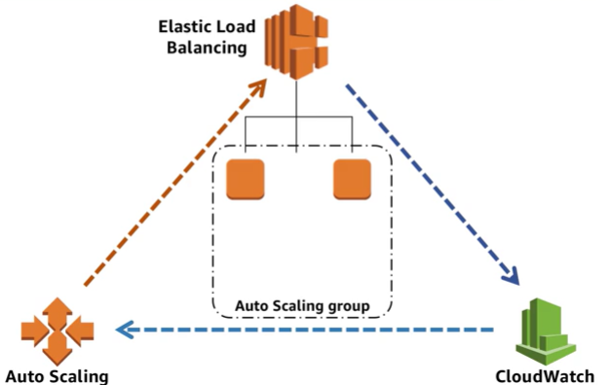
Dynamic Auto Scaling
Notes:
So, how does dynamic automatic scaling work? One common configuration is to create CloudWatch alarms based on performance information from your Amazon EC2 instances or a load balancer.
When a performance threshold is breached, a CloudWatch alarm triggers an automatic scaling event which either scales out or scales in Amazon EC2 instances in the environment.

Slide 32




In Review
Ensure that your architecture can handle changes in demand.
A key advantage of a cloud-based infrastructure is how quickly you can respond to changes in resource needs.
App servers at alarm threshold
Users never experience interruption in accessibility
Auto Scaling is alerted and scales out
Best practice
New server is ready before capacity is reached
Notes:
In summary, using the best practice of enabling scalability will enable you to anticipate needs and have more capacity available before it’s too late.
Ensure that your architecture can handle changes in demand. A monitoring solution, such as Amazon CloudWatch, detects that the total load across the fleet of servers has reached a specified threshold of load. This could be anything, such as "Stayed above 60% CPU utilization for longer than 5 minutes," or anything related to the use of resources. With CloudWatch, you can even design custom metrics based around your specific application, which can trigger scaling in whatever way you need. When that alarm is triggered, Amazon EC2 Auto Scaling immediately launches a new instance.
A key advantage of a cloud-based infrastructure is how quickly you can respond to changes in resource needs. An instance can be ready before capacity is reached, providing a seamless experience for users, who will never know that capacity was in danger of being reached.
Ideally, you should also design this system to scale down once demand drops off again, so that you're not running instances that are no longer needed.

Slide 33

Module 2, Section 5, Lab 5: Scale and Load Balance your Architecture
~ 45 minutes
Notes:
Introducing Section 5: Lab 5: Scale and Load Balance your Architecture.

Slide 34
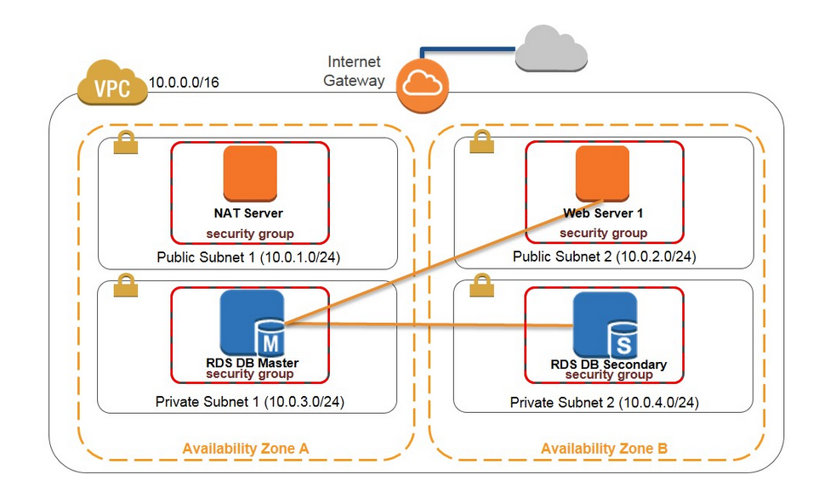
Lab 5: Scenario
In this lab, you will start with an infrastructure that needs improvements in terms of scaling and load balancing. Your starting infrastructure is shown below:
Notes:
In this lab, you will start with an infrastructure that needs improvements, in terms of scaling and load balancing. Your starting infrastructure is displayed.
Elastic Load Balancing distributes incoming application traffic across multiple Amazon EC2 instances. It enables you to achieve fault tolerance in your application by seamlessly providing the required amount of load balancing capacity needed to route application traffic.
Elastic Load Balancing offers two types of load balancers that both feature high availability, automatic scaling, and robust security. These are the Classic Load Balancer, which routes traffic based on either application- or network-level information, and the Application Load Balancer, which routes traffic based on advanced application-level information that includes the content of the request. The Classic Load Balancer is ideal for simple load balancing of traffic across multiple Amazon EC2 instances, and the Application Load Balancer is ideal for applications that need advanced routing capabilities, microservices, and container-based architectures. The Application Load Balancer offers you the ability to route traffic to multiple services or load balance across multiple ports on the same Amazon EC2 instance.
Automatic scaling helps you maintain application availability and allows you to scale your Amazon EC2 capacity out or in automatically according to conditions you define. You can use automatic scaling to help ensure that you are running your desired number of Amazon EC2 instances. Automatic scaling can also automatically increase the number of Amazon EC2 instances during demand spikes to maintain performance and decrease capacity during lulls to reduce costs. Automatic scaling is well suited to applications that have stable demand patterns or that experience hourly, daily, or weekly variability in usage.
Upon completing this lab, you will be able to:
Create an Amazon Machine Image from a running instance.
Create a load balancer.
Create a launch configuration and an Auto Scaling Group.
Automatically scale new instances within a private subnet.
And create Amazon CloudWatch alarms to monitor performance of your infrastructure.
This lab will take approximately 45 minutes.

Slide 35

Lab 5: Tasks
Create an Amazon Machine Image (AMI) for Auto Scaling.
Create an Application Load Balancer.
Create a Launch Configuration and put it in a security group.
Create and test automatic scaling to verify that it is working.
EC2 Instance
Application Load Balancer
Web Server
EC2 Instance
Auto Scaling
Notes:
The focus of this lab, is to:
Create an Amazon Machine Image (or AMI) for Auto Scaling.
Create an Application Load Balancer.
Create a Launch Configuration and put it in a security group.
Create and test automatic scaling to verify that it is working.

Slide 36
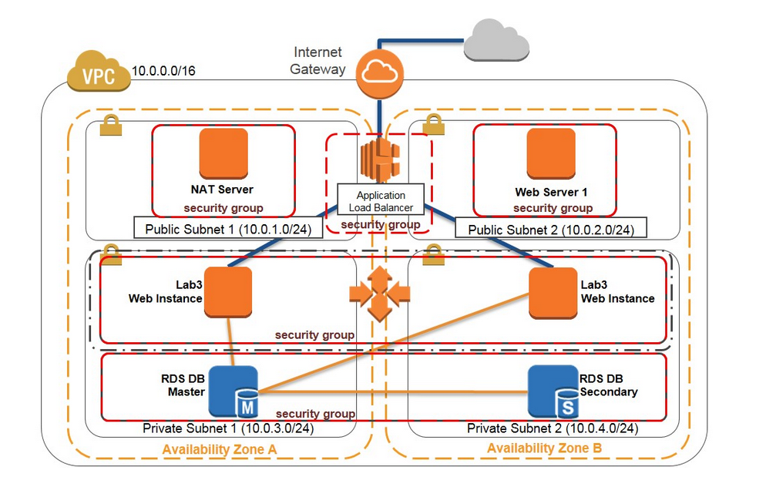
Lab 5: Final Product
~ 45 minutes
~ 45 minutes
Notes:
In this lab, you:
Created an Amazon Machine Image (AMI) from a running instance
Created an application load balancer.
Created a launch configuration and an Auto Scaling Group.
Automatically scaled new instances within a private subnet.
Created Amazon CloudWatch alarms and monitor performance of your infrastructure.

Slide 37

Module 2.0.5 Review:
Introduced the Elastic Load Balancing
Reviewed CloudWatch features
Explained automatic scaling
To finish this module:
Complete:
Knowledge Assessment
Notes:
In review, we:
Introduced Elastic Load Balancing.
Briefly reviewed Amazon CloudWatch and the valuable information it provides for monitoring your resources.
Explained automatic scaling.
To finish this module, please complete the lab and the corresponding knowledge assessment.

Slide 38
Up Next: Module 3 – Cloud Security AWS Shared Responsibility Model AWS Identity and Access Management (IAM) AWS Trusted Advisor AWS CloudTrail AWS Config AWS Day One Best Practices AWS Security and Compliance AWS Security Resources
Notes:
In Module 3, we will review important aspects of cloud security.

Slide 39
Thanks for participating!
© 2018 Amazon Web Services, Inc. or its affiliates. All rights reserved. This work may not be reproduced or redistributed, in whole or in part, without prior written permission from Amazon Web Services, Inc. Commercial copying, lending, or selling is prohibited. Corrections or feedback on the course, please email us at: aws-course-feedback@amazon.com. For all other questions, contact us at: https://aws.amazon.com/contact-us/aws-training/. All trademarks are the property of their owners.
Notes:
Thanks for participating!

